Slide 1

Customer Churn Predictions using ml
Les clairvoyants
9.24.XX

Slide 2

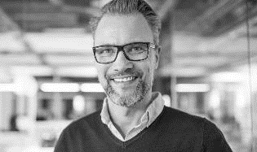



Meet the team
RITA STARZYK
CHADI GHOSN
YEVGENIY DENKOVYCH
KIRRAN KAYANI

Slide 3

Agenda
INTRODUCTION
PROJECT DIAGRAM
ETL PROCESS
TABLEAU
INSIGHTS & OBSERVATIONS
ML MODELS
AI SELENIUM CODE

Slide 4

INTRODUCTION
HOW WE DID LAST YEAR
Profits are up, and losses are down! We are very proud of the progress our team has made.
Today we’ll review our wins and losses from last year and give you an overview of what you can expect for next year.

Slide 5
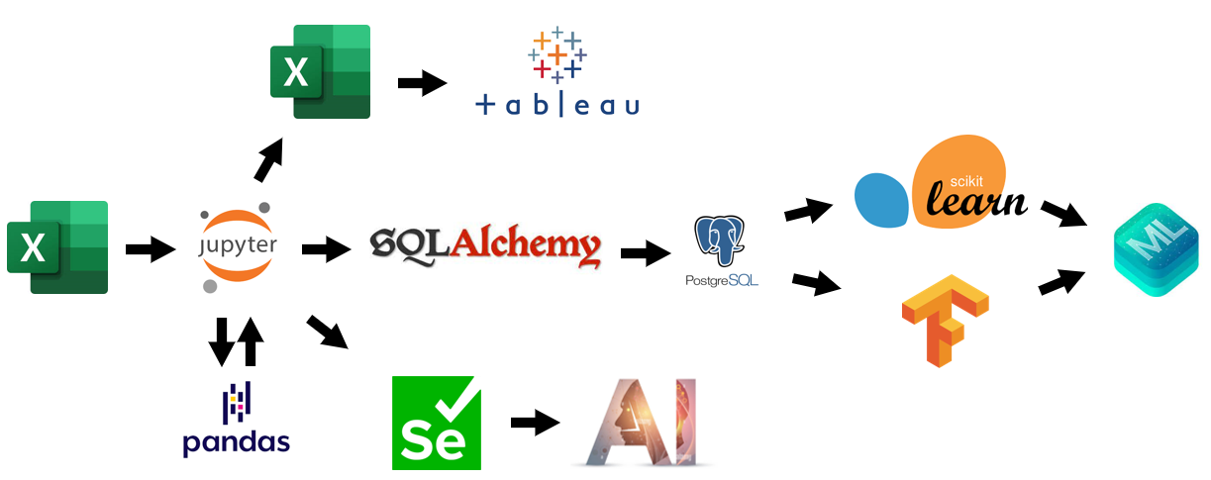
Project diagram

Slide 6

ETL PROCESS
Let’s Dive In

Slide 7

TABLEAU
DASHBOARD PRESENTATION

Slide 8
INSIGHTS & OBSERVATIONS
Let’s Dive In

Slide 9
ML MODELS
Model scores and performance

Slide 10
AI SELENIUM CODE
EXTERNAL AI WEBSITE

Slide 11
ANY QUESTIONS?
THANK YOU

